Slide 1
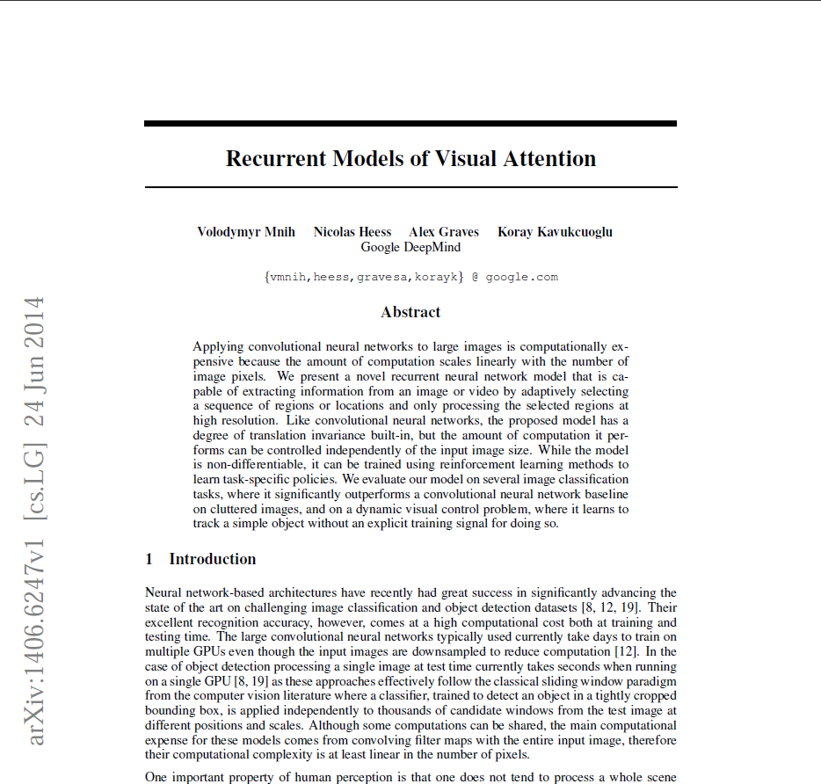

Slide 2
J. M. Allred and K. Roy, "Convolving over time via recurrent connections for sequential weight sharing in neural networks," 2017 International Joint Conference on Neural Networks (IJCNN), Anchorage, AK, 2017, pp. 4444-4450. doi: 10.1109/IJCNN.2017.7966419

Slide 3
J. M. Allred and K. Roy, "Convolving over time via recurrent connections for sequential weight sharing in neural networks," 2017 International Joint Conference on Neural Networks (IJCNN), Anchorage, AK, 2017, pp. 4444-4450. doi: 10.1109/IJCNN.2017.7966419

Slide 4
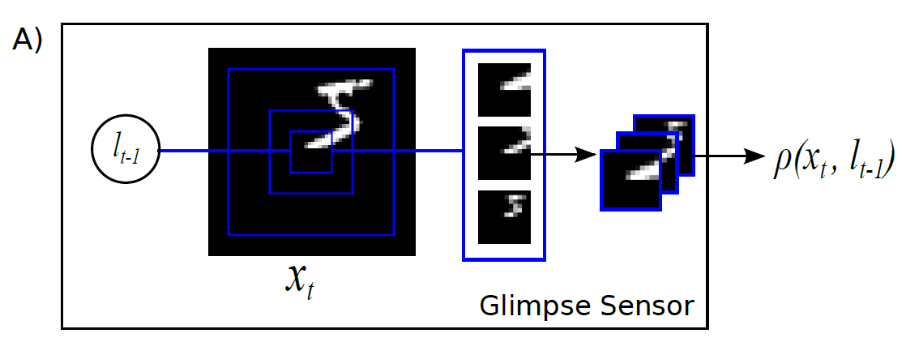
Broad strokes
A recurrent network recieves a foveated input image
It processes and stores information in its hidden states
A new location for the centre of the 'glimpse' is output
An action is selected
This repeats until the end of the task

Slide 5
Motivation
Reduce the number of network parameters
Reduce the input space – fast compute, less resource
Biological compatability
Cropping an image can reduce task difficulty
Network complexity not dependent on input size

Slide 6
Methods
Location is drawn from distribution, mean from network and fixed variance - discrete failed
Action is task dependent
BP and RL to train the network
Core network uses LSTMs
Rest is fully connected linear rectifier

Slide 7
Maths
POMDP
Cross-entropy was used to train the network when performing classification

Slide 10
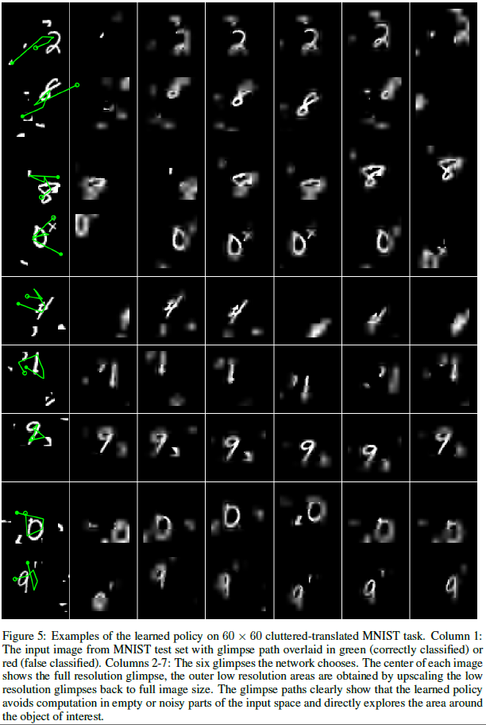
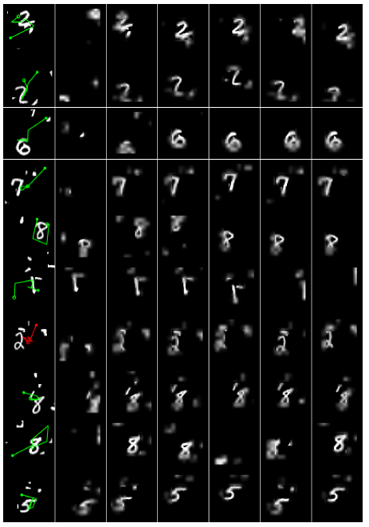

Slide 12
Comments
Talk about better generalisation compared to other but no comparison
Unclear topology for each experiment
Unknown number of epochs to train/converge

Slide 13
Feedback
What can be improved?
More or less detail?
Any particular snacks?
Length?
Topic?
More discussion, less presenting?
Journal club name?

